Slide 1
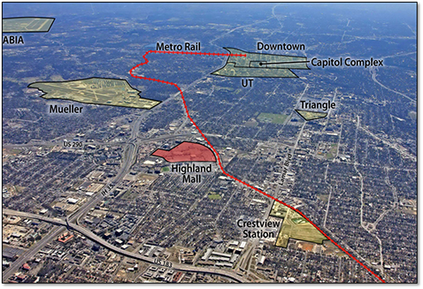
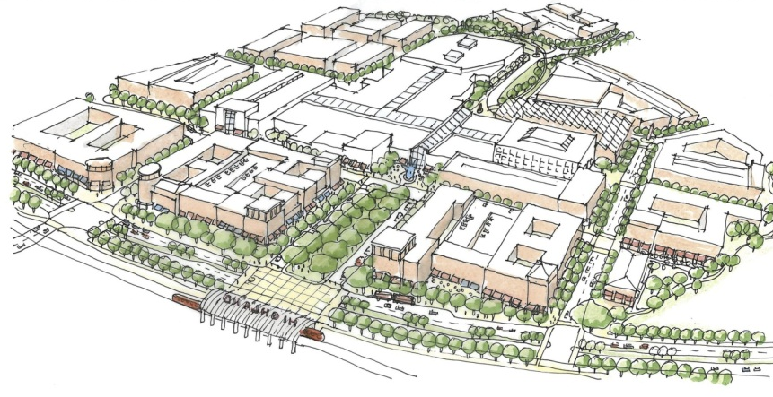
A NEW VISION FOR HIGHLAND
Transforming a Retail Center into a Center of Excellence
Project Overview – October 2012

Slide 2
Highland Redevelopment | An Overview
1. Introduction
History
Location
Success checklist
2. Models for Consideration
Mixed-use, education-focused examples
Mall redevelopment examples
Austin infill examples
3. Development Overview
Project comparison snapshot
Plans from the community
Guiding principles
Potential character images
Process
Roles & responsibilities
Programming
4. Next Steps

Slide 3
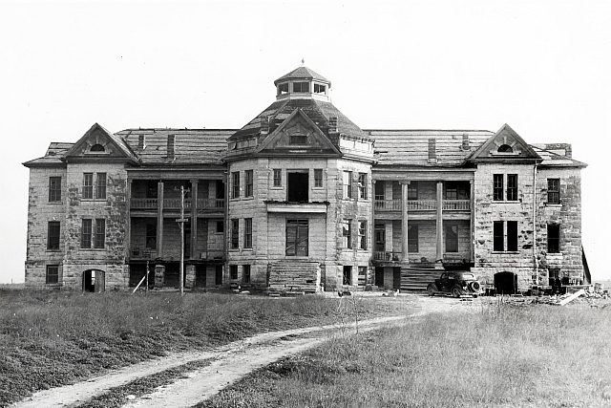
Introduction | History
Prior Use:
The property was farmland; an orphanage was nearby
1971:
Opened as Austin’s first indoor mall
1970s-early 2000s:
Successful retail operations and anchor for north central Austin
Early 2000s:
Decline of mall and closure of anchor stores
May 2010:
ACC and RedLeaf initiated purchase and redevelopment of Highland property
An orphanage once stood just North of where Highland Mall is located today.
Aerial photograph of Highland area in 1951.
Highland Mall had high volumes of traffic for decades.

Slide 4
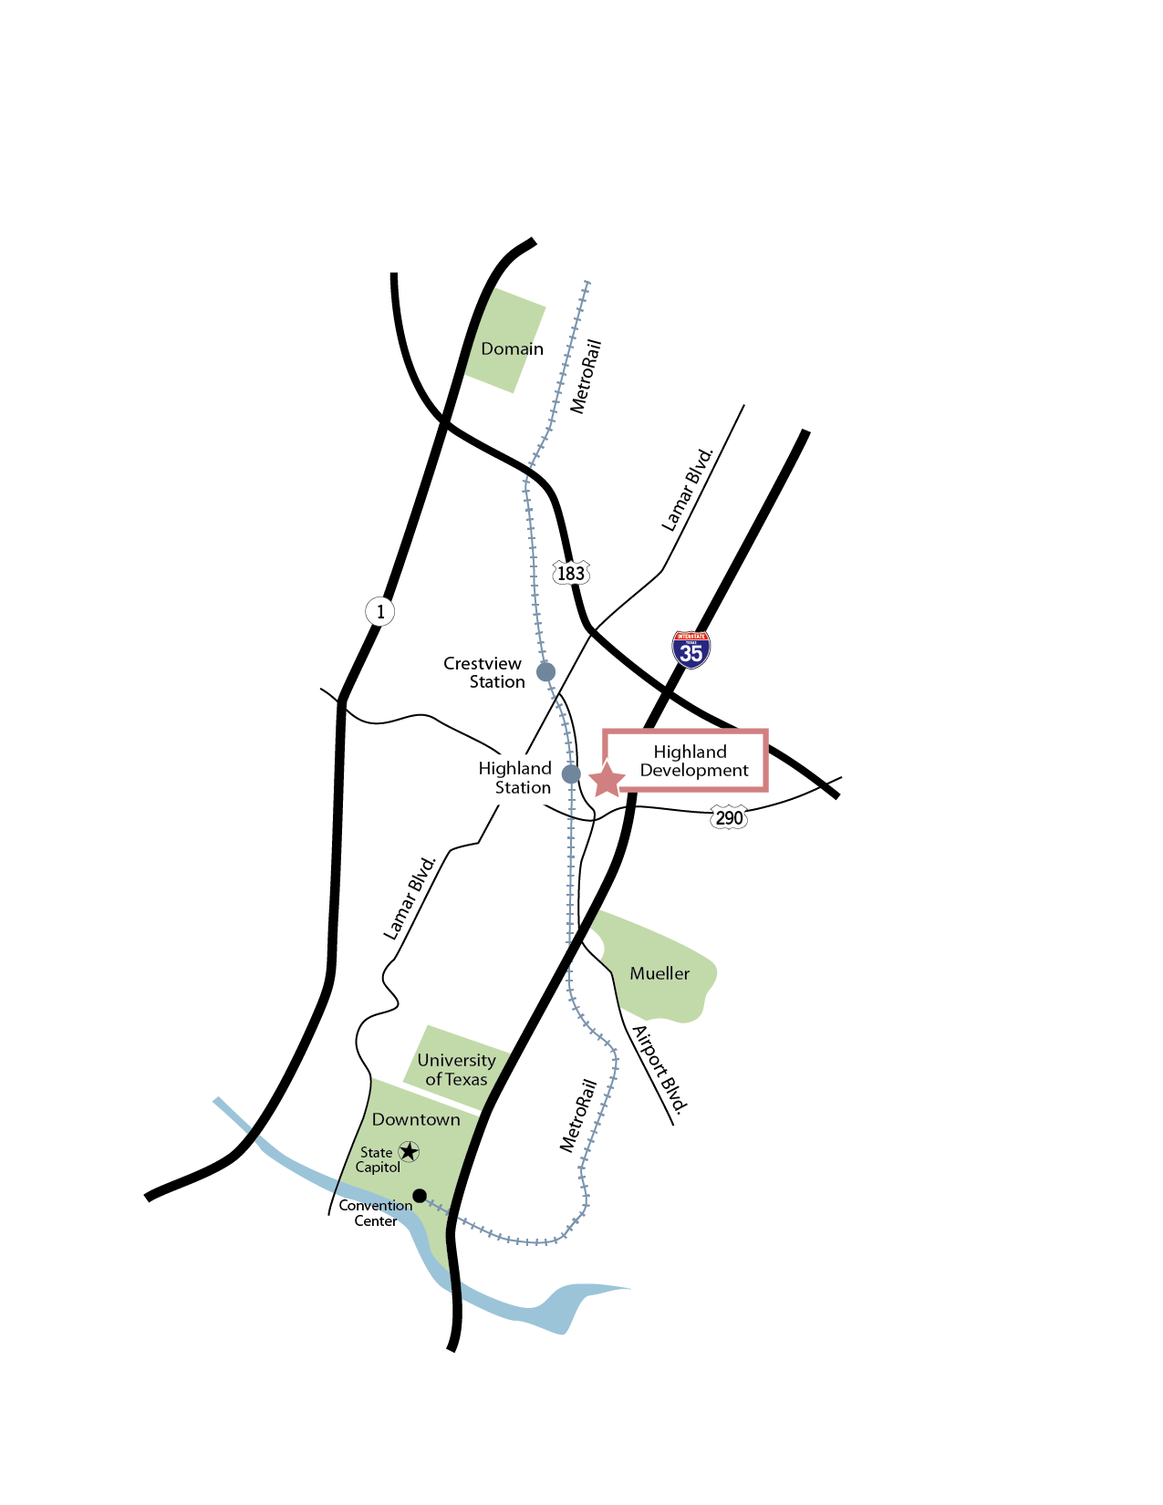
Introduction | Location
Convenient access to MetroRail service
Near geographic, population center of Austin
Just a few miles from downtown, UT
Close to I-35, US 290,
US 183, RR 2222

Slide 5
Introduction | Success Checklist
Successful urban redevelopments typically have:
Quality Location ✓
Quality Architecture ✓
Community and Political Support ✓
Transit Options ✓
Strong Anchor Use ✓
Sensible Financial Structure ✓
Public / Private Partnerships ✓
Flexible Plans ✓
Aligned Incentives ✓

Slide 6
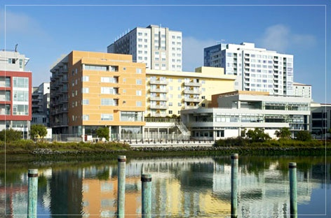
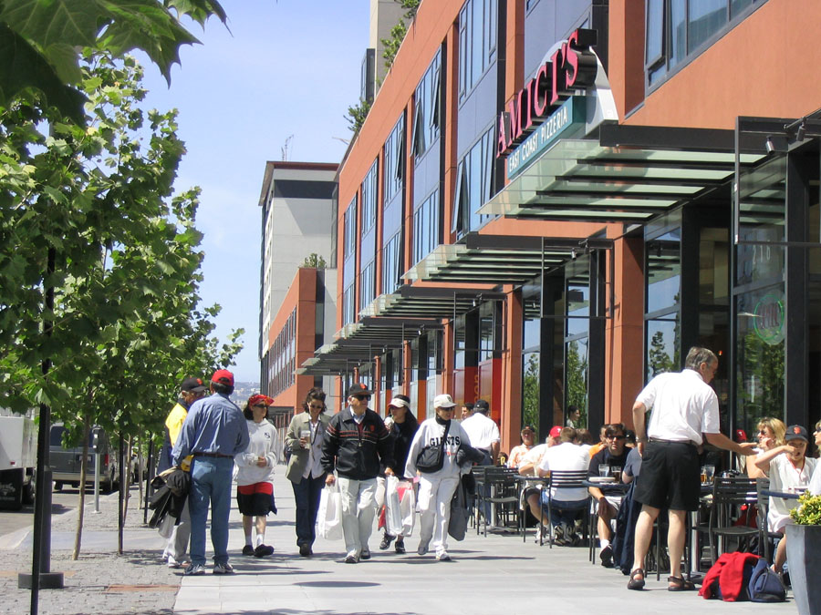
Models | Mixed-Use, Education Projects Mission Bay, San Francisco
303 acres
Mixed-use redevelopment – converted landfill and rail yard
2.7 million sf campus for UC San Francisco
6,000 residential units
800,000 sf of retail
50 acres parks and open space
5 million sf of commercial

Slide 7
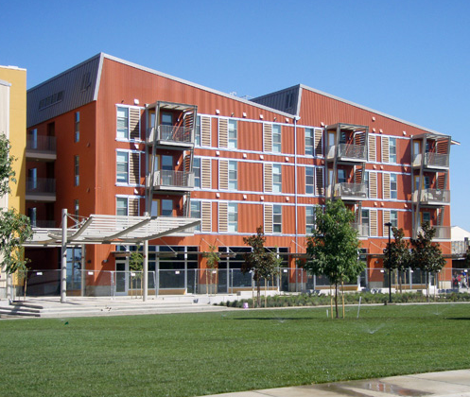
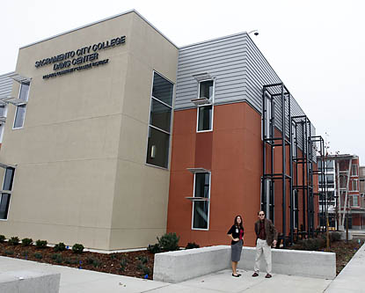
Models | Mixed-Use, Education Projects UC Davis West Village, Davis, California
130 acres at the edge of UC Davis on university-owned land
Largest energy-neutral housing project in the nation
On-site community college center to recruit and help with transitioning to a 4-year university
Initially, 2,400 students – planned to reach 4,500 students
Includes housing for faculty and staff
$17 million in infrastructure costs funded by UC Davis to be recouped in energy bills
$263 million invested by private developer; utilized tax credits and incentives
$7.5+ million secured in state and federal planning grants
After

Slide 8
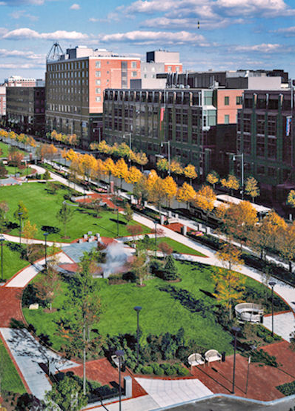
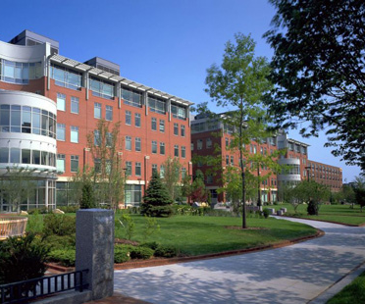
Models | Mixed-Use, Education Projects University Park at MIT, Boston
27 acres at the edge of campus on university-owned land that contained demolished manufacturing buildings and had lain vacant for decades
1.3 million sf of research and office space across 10 buildings
250,000 sf of hotel, restaurant and retail space
674 residential units
3 parking structures provide 2,700 total spaces
Park areas, plazas and extensive landscaping
After

Slide 9
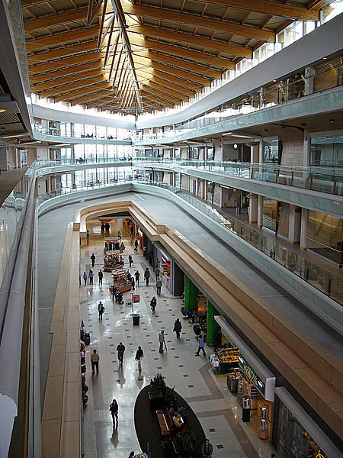
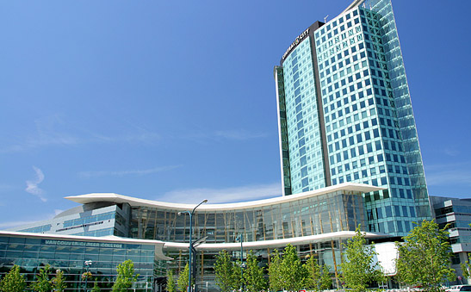
Models | Mixed-Use, Education Projects Surrey Central City, British Columbia, Canada
Shopping mall originally constructed in the 1960s
ICBC, an insurance company, purchased the declining mall and proceeded with transforming it into a mixed-use center in 2003
Simon Fraser University is located in a four-story campus above the mall space that serves approximately 5,000 students
Transit constructed on-site

Slide 10
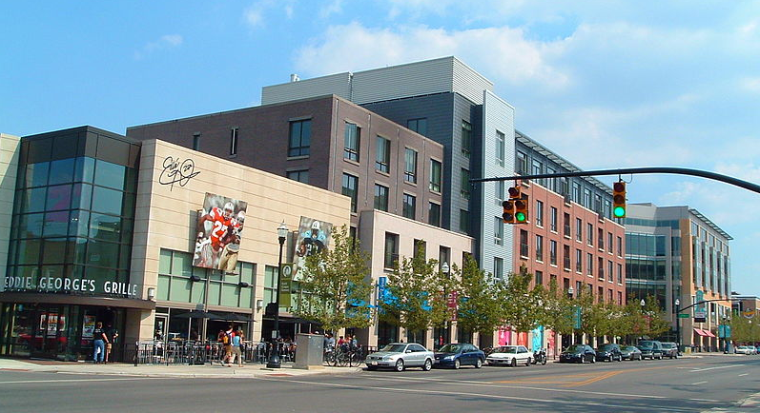
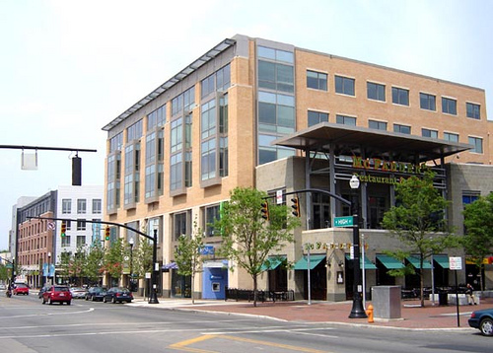
Models | Mixed-Use, Education Projects OSU South Campus Gateway, Columbus, Ohio
Formerly a run-down part of town on seven acres near student housing and entertainment
OSU wanted to improve the neighborhood around campus and the stature of the university
OSU, City of Columbus formed nonprofit Campus Partners to acquire and redevelop the urban environment near campus
South Campus Gateway covers 550,000 total sf of retail, office, housing, parking garage and movie theater
Improved streetscape and landscaping for student traffic

Slide 11
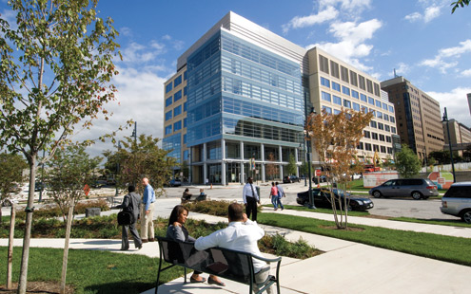
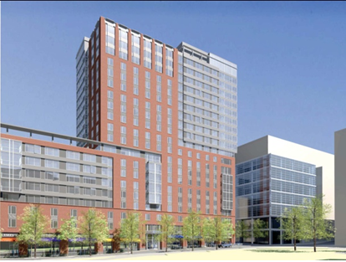
Models | Mixed-Use, Education Projects Science + Technology Park, Johns Hopkins, Baltimore
31-acre research and office park
1.1 million sf of lab and office space planned in multiple buildings – the first building is complete
Also planned are 2,200 residences, retail space, school, park and structured parking
Part of a larger 88-acre East Baltimore effort to demolish distressed neighborhood and create mixed-income residential community

Slide 12
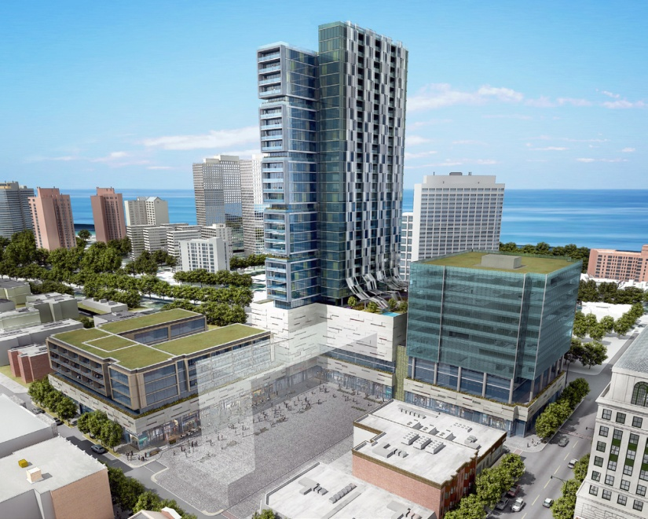
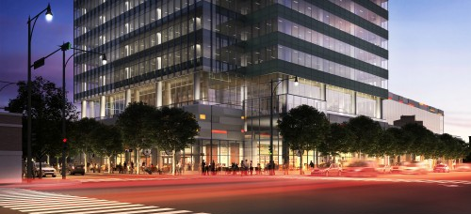
Models | Mixed-Use, Education Projects Harper Court, near University of Chicago
University purchased the 3.3-acre property, containing shopping center
Project is part of the 53rd Street TIF, will receive $23+ million for infrastructure, other public improvements
Planned as a 1.1 million sf redevelopment in two phases: office and retail space, residential units, a hotel and structured parking
Phase I under construction now

Slide 13
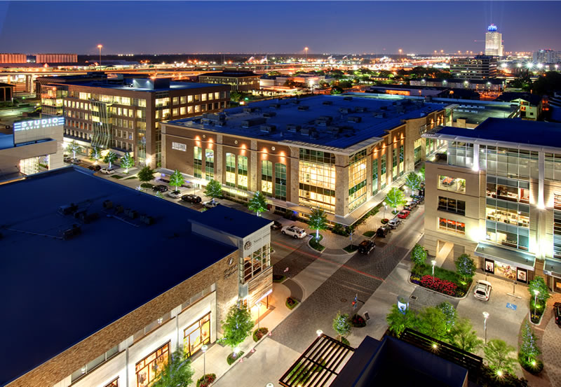
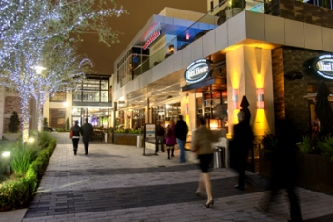
Models | Mall Redevelopment Project CityCentre, Houston
Built on 37-acre site of former Town & Country Mall
Redeveloped as a walkable, mixed-use community using existing structured parking
1.8 million square feet of development underway:
- 425,000 sf of office space
- 400,00 sf of retail, restaurants and entertainment
- 149,000 sf fitness center
- 600+ residential units, including some for-sale townhomes
- 255 room luxury hotel
After

Slide 14
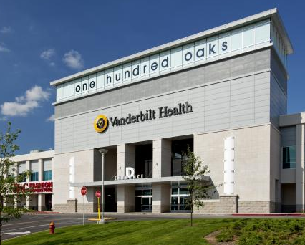
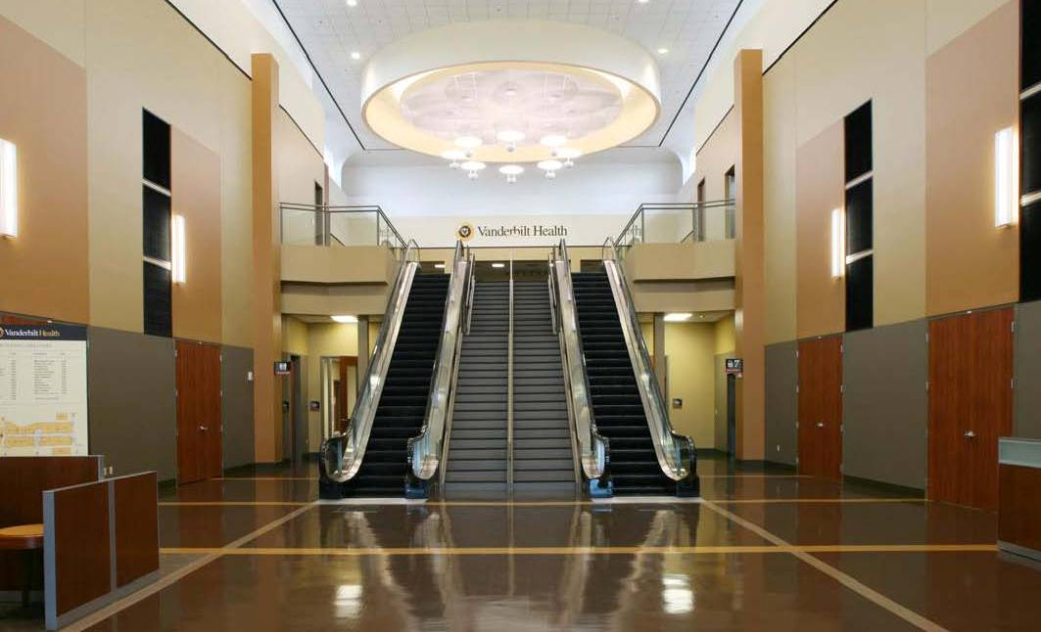
Models | Mall Reuse Project Vanderbilt Health at One Hundred Oaks, Nashville
Nashville’s first enclosed shopping mall, opened in 1967
56 acres and 888,000 sf
Nearby Vanderbilt entered into partnership with redeveloper in 2007 after period of decline
Leased 436,000 sf on upper level with right to purchase entire property
Developer improved shell and site work, university improved interior
Most retailers are still located on ground level of mall and remained open during redevelopment

Slide 15
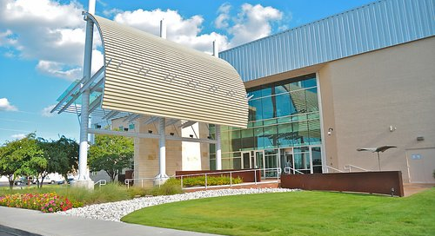
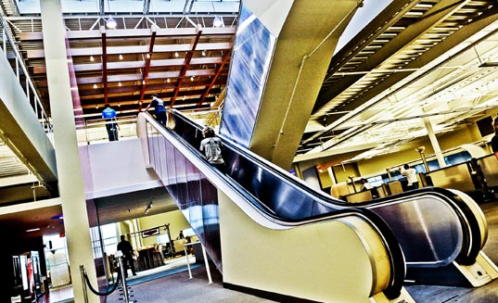
Models | Mall Reuse, Redevelopment Project Rackspace Headquarters, San Antonio
Originally a 1.2 million sf mall
Opened in 1976; area declined and mall closed in 2005
City of Windsor Park purchased property and struck relocation deal with Rackspace
Rackspace repurposed former mall buildings into corporate office space
To date, three phases completed with 2,500 employees
More phases planned to eventually accommodate 5,000 employees
After

Slide 16
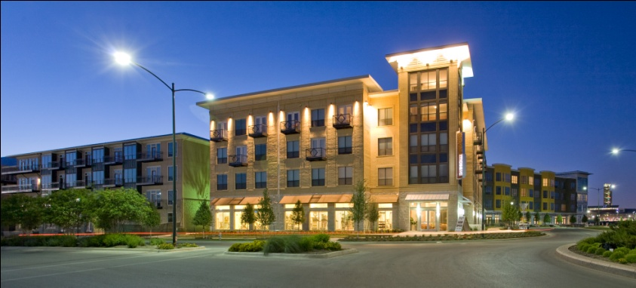
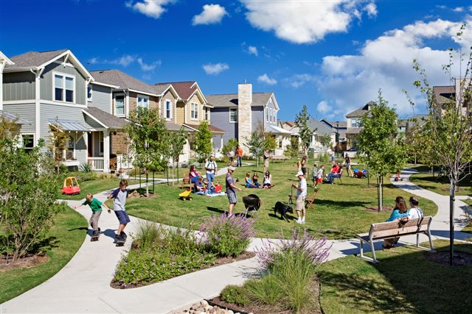
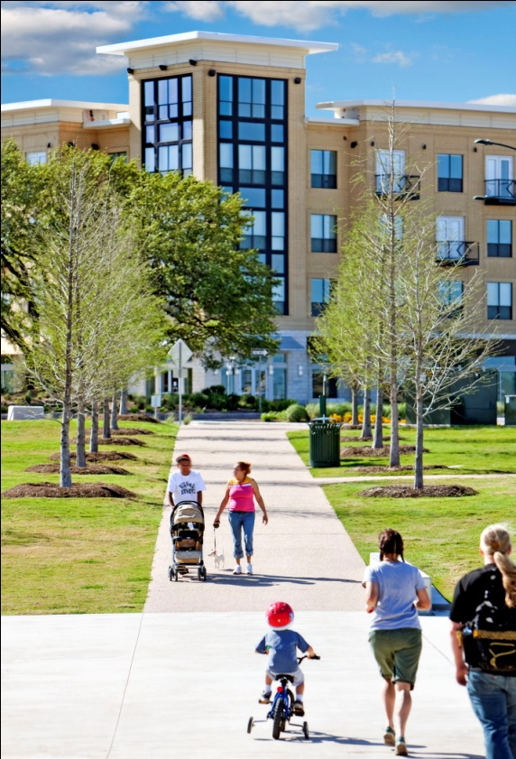
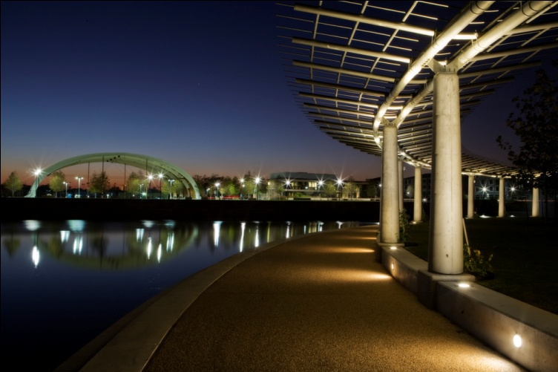
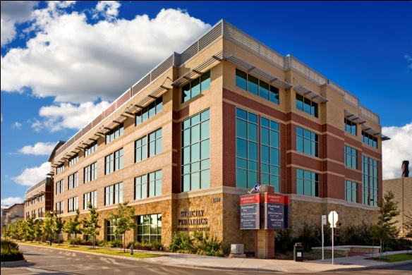
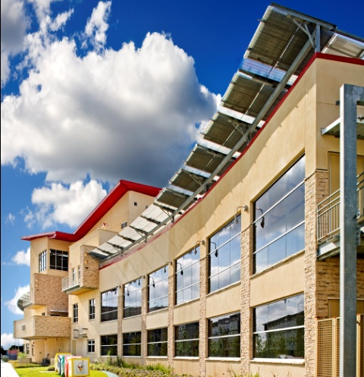
Models | Austin Infill Projects Mueller, Austin

Slide 17
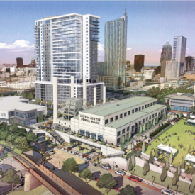
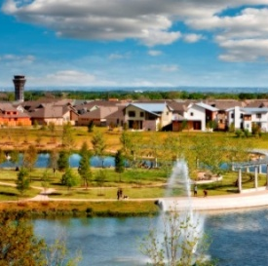
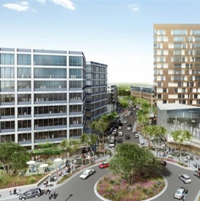
Development | Project Comparison Snapshot
 | Highland |  | Green Water | Seaholm | Mueller | University Park | Domain
Developer/Owner | ACC/RedLeaf |  | City of Austin/ Trammell Crow | City of Austin/ Southwest Strategies | City of Austin/ Catellus | Cypress Real Estate Advisors | Endeavor
Acres of Land | 81 |  | 4 | 8 | 711 | 23 | 303
Institutional SF | 1,300,000 |  | 0 | 0 | 1,900,000 | 0 | 0
Residential Units* | 1,350 |  | 825 | 300 | 4,900 | 1,000 | 3,000
Office SF | 900,000 |  | 455,000 | 130,000 | 1,900,000 | 700,000 | 2,000,000
Retail SF | 150,000 |  | 80,000 | 40,000 | 650,000 | 300,000 | 1,500,000
Hotel Rooms** | 200 |  | 200 | 0 | 100+ | 200 | 400+
Primary Anchor | ACC |  | TBD | Trader Joe’s | Seton | Longhorn Network | Various Retail
Total SF | Planned: | 3,510,000 | 1,275,000 | 410,000 | 8,410,000 | 1,960,000 | 6,060,000
 | Zoned: | 7,000,000
*
**
Residential units assumed to average 800 SF for total SF estimate
Hotel rooms assumed to average 400 SF for total SF estimate
Programs are approximate

Slide 18
Development | Plans from the Community
Highland/Brentwood Combined Neighborhood Plan
Focus on higher density and mixed uses on major corridors
Corridors enhanced with aesthetically pleasing and pedestrian-friendly redevelopment
New parks and green spaces
Improved drainage along creeks and streets
Imagine Austin
Highland site is designated as a regional center
Regional centers are urban retail, cultural, recreational, and entertainment destinations
Most dense and urban designation
Envision Central Texas
Has preference for compact and connected redevelopment along existing corridors

Slide 19
Development | Guiding Principles
Success based on a CLEAR VISION and FLEXIBLE PLAN
Guiding Vision Principles
Educational focus
Economic vitality
Sustainability
Mixed-use design
Multi-modal connectivity
Compatibility

Slide 20
Development | Guiding Principles
Educational Focus
Support ACC’s educational mission: respect individual students, promote their success, improve communities through traditional and innovative learning modes
Identify appropriate private and public partners to support ACC’s and its students’ successes
Create physical spaces conducive to student living and learning

Slide 21
Development | Guiding Principles
Economic Vitality
Attract significant private investment
Create short- and long-term employment opportunities
Revitalize the core of Austin with a new activity center
Expand local property and sales tax base for multiple government entities:
- Austin Community College District
- City of Austin
- Travis County
- Austin ISD
- Central Health
- State of Texas

Slide 22
Development | Guiding Principles
Sustainability
Create an environment that embraces green-building and the sustainable values of ACC and RedLeaf. Considerations include:
Transforming auto-dependent, single-use into a multi-modal mix of uses
Building to LEED-certification standards
Establishing area storm water filtration system
Planting 1,000+ trees and native/drought-tolerant landscaping
Reducing impervious cover, creating new open space
Installing photovoltaic panels
Collecting rainwater and A/C condensation

Slide 23
Development | Guiding Principles
Mixed-Use Design
Diversity of uses:
Living, studying, shopping, working, eating and playing
Diversity of people:
students, faculty, residents, employees, neighbors and visitors
Diversity of dayparts:
Morning, noon and night | weekday and weekend
Diversity of design:
Building types, heights, finish materials, public spaces

Slide 24
Development | Guiding Principles
Multi-Modal Connectivity
One of Austin’s largest transit-oriented sites
- Served by MetroRail; working to improve connectivity
- Central hub and transfer point for bus service
Abundant pedestrian- and cyclist-friendly features aligned with Airport Blvd. efforts
Stellar arterial access:
- I-35
- U.S. 290
- U.S. 183
- RR 2222/Koenig Lane

Slide 25
Development | Guiding Principles
Compatibility
Transforming dying mall’s urban blight into new-urban oasis
Convenient access to ACC programs
Multi-modal access to/from surrounding neighborhoods
Significant open space
Local-serving businesses

Slide 26
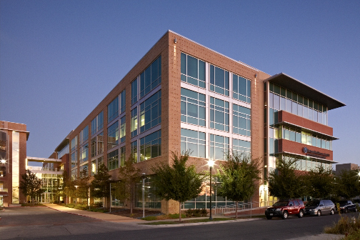
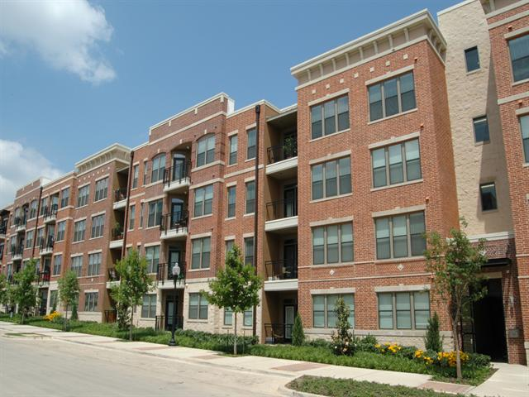
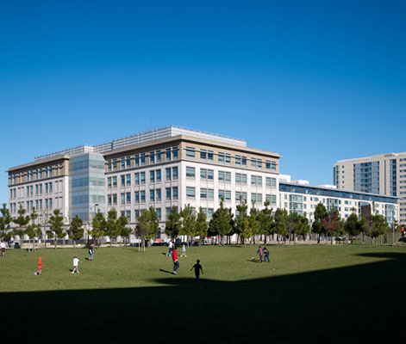
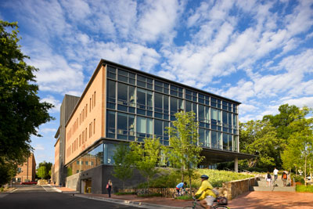
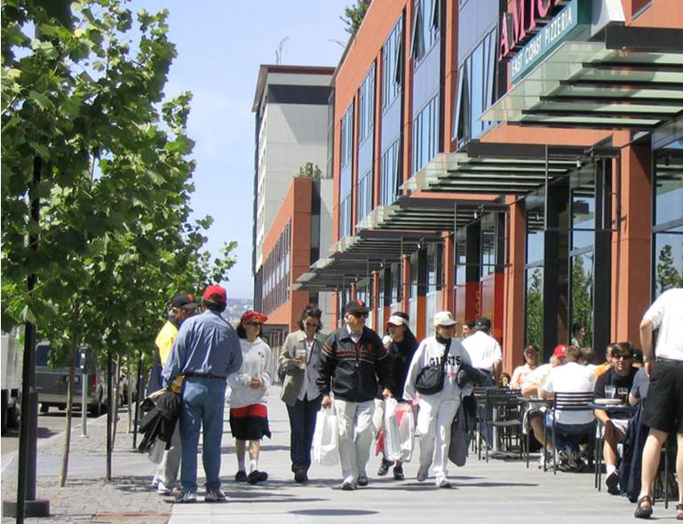
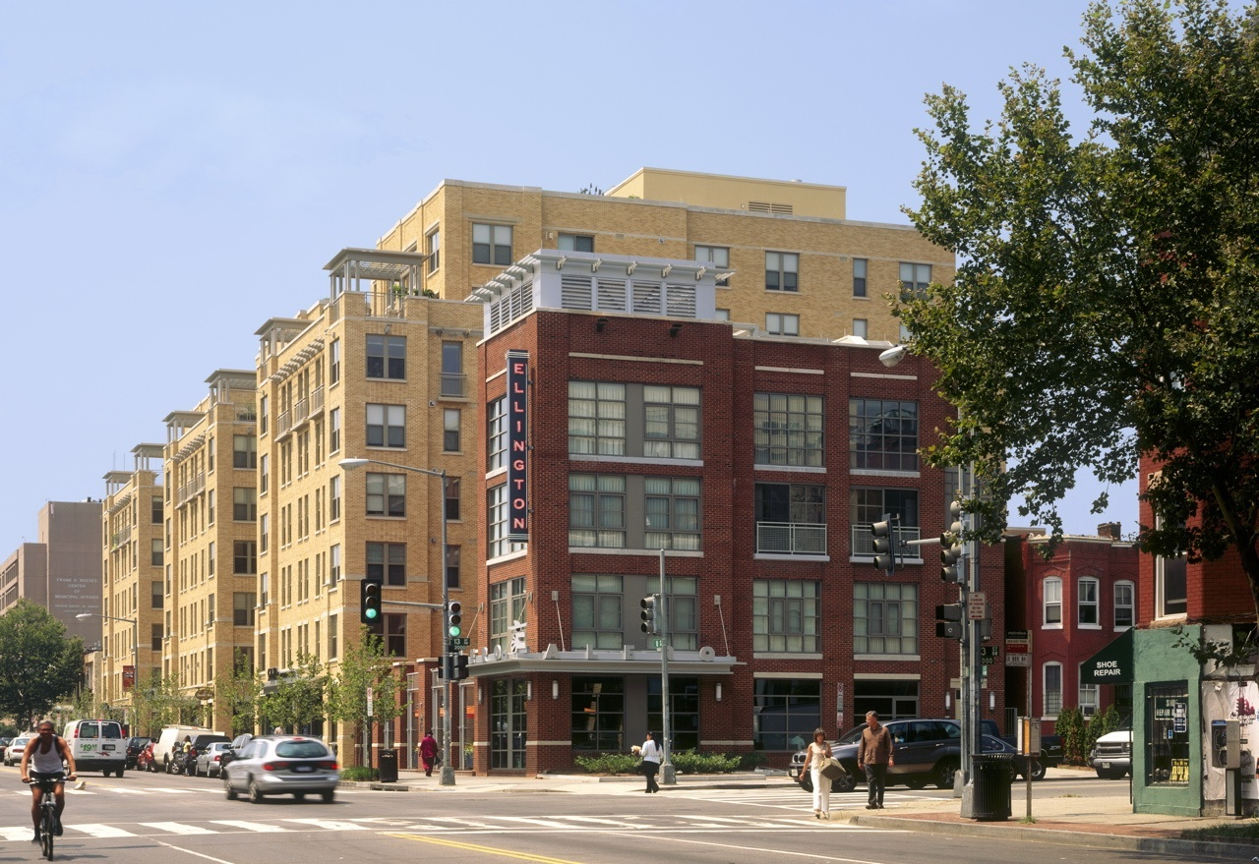
Development | Potential Character Images

Slide 27
Process Roadmap from August 2010
Acquire Tract 1 -- COMPLETE
Acquire Tract 2 – IN PROCESS
Acquire Tract 3 – IN PROCESS
Acquire Tract 4 -- PENDING
STEP 1:
Acquisition
Community involvement/engagement
Master planning
Infrastructure plan
Financial plan
Entitlement agreement with COA
Establish community governance, architectural controls and common maintenance cost sharing
Infrastructure phasing plan
STEP 2:
Preparation
STEP 3:
Implementation
Design and construction
Marketing and development

Slide 28
Development | Process Roadmap for Success
Acquisition
Planning
(Current Activity)
Development
RedLeaf/ACC Agreements
– November 2009
Acquisition of Property:
Dillards – Closed May 2010
Macys – Closed Dec 2010
AIG – Closed May 2011
Greyhawke – Closed Aug 2011
LNR – Closed Aug 2012
TxDOT– Closed Aug 2012
ACC Academic Master Plan
(under way)
Overall Project Master Plan
(under way)
Infrastructure Plan
(under way)
Community Engagement
(under way)
Infrastructure Finance Plan
(under way)
Zoning Modification
(under way)
Community Governance
(under way)
Design
(JC Penney design underway)
(Infrastructure design underway)
Construction
Marketing
Sales

Slide 29
Development | Roles and Responsibilities
ACC as Landowner/
Partner:
Maintain interim ownership of the non-college parts of the property
Oversight and approval of all decisions
Share in costs that benefit both college and non-college uses
ACC as Institutional Anchor:
Establish a master plan for college uses
Form innovative public/public and public/private partnerships
Design, construct, fund and operate college facilities
RedLeaf as Master Developer:
Oversee, manage and implement all shared and non-college parts of the project subject to oversight and approval by ACC
Share in costs that benefit both college and non-college uses

Slide 30
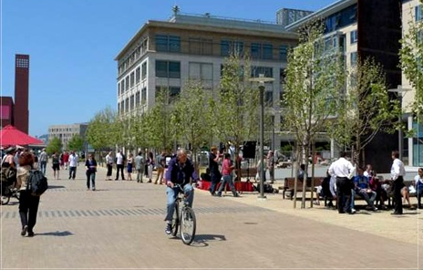
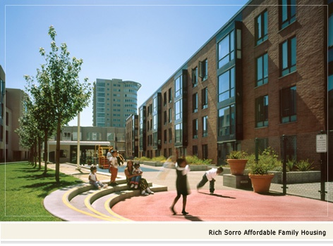
Development | Programming
Non-College Uses
Residential – apartments
Residential – condo
Office
Retail and entertainment
Hospitality
Mix and timing of projects and uses will be
market-driven and coordinated with timing of ACC improvements

Slide 31
Development | Programming
First Phases of Development
JC Penney building
First development blocks to be delivered

Slide 32
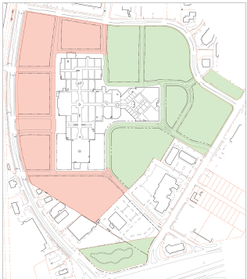
Development | Programming
Infrastructure Phasing
Design in Progress
Planning in
Progress

Slide 33
Next Steps
Partnerships
City of Austin – form based code, development agreement appropriate for a long term project
CapMetro – short and long term mobility plans
Travis County & Others
Governance
Ensure long-term protection of the vision with quality architecture and system to fund maintenance
Communication
Individual group meetings
Presentations
Refine Phasing Plan
Respond to opportunities and issues as they arise

Slide 34
